Slide 1
Capstone: Credit Card Fraud detection
Presenter: Yap Yeong Cherng

Slide 2
Biography
REC Solar Pte Ltd
Industrialization, Process Engineer
Student in Institute of Data
Looking to involve data science into future career
University of Technology, Sydney
Bachelor of Science (Physics and Advanced Materials)
Republic Polytechnic
Diploma in Material Science

Slide 3
Business Context / Data Question
Credit card fraud
In 2019, fraud losses reached $28 billion with USA alone, responsible for more than a third of total global loss.
With the Coronavirus pandemic and fraud attacks becoming more successful, there is a fuelling growth in card fraud and this trend is expected to grow over the coming years.
Can we use a model to predict who would likely become targets of fraud ?
Notes:
https://www.cnbc.com/2021/01/27/credit-card-fraud-is-on-the-rise-due-to-covid-pandemic.html
https://www.kaggle.com/mlg-ulb/creditcardfraud

Slide 4
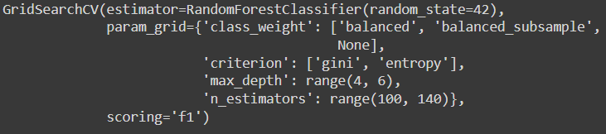
Design
1)Forward Feature Selection
2)Check model performance
- Confusion Matrix
-ROC curve
3)Hyperparameters tuning
1) Decision Tree
2) Random Forest
3) AdaBoost
4) Sequential
5) Voting
(Decision Tree / Random Forest)
1)Data Cleaning 2)EDA
1) Best Model testing
2) Verification

Slide 5
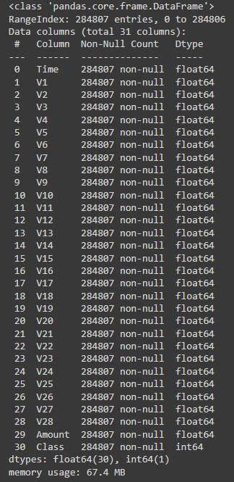
Data / EDA
Credit card fraud dataset from Kaggle
28 features (V1-V28)
Standardised
284807 rows , 31 columns
Fraud: 492
No Fraud: 284315
Split train test with test size 0.2
Split / randomise into smaller data set
Fraud: 164
No Fraud: 500
Notes:
https://www.kaggle.com/datasets/mlg-ulb/creditcardfraud

Slide 6
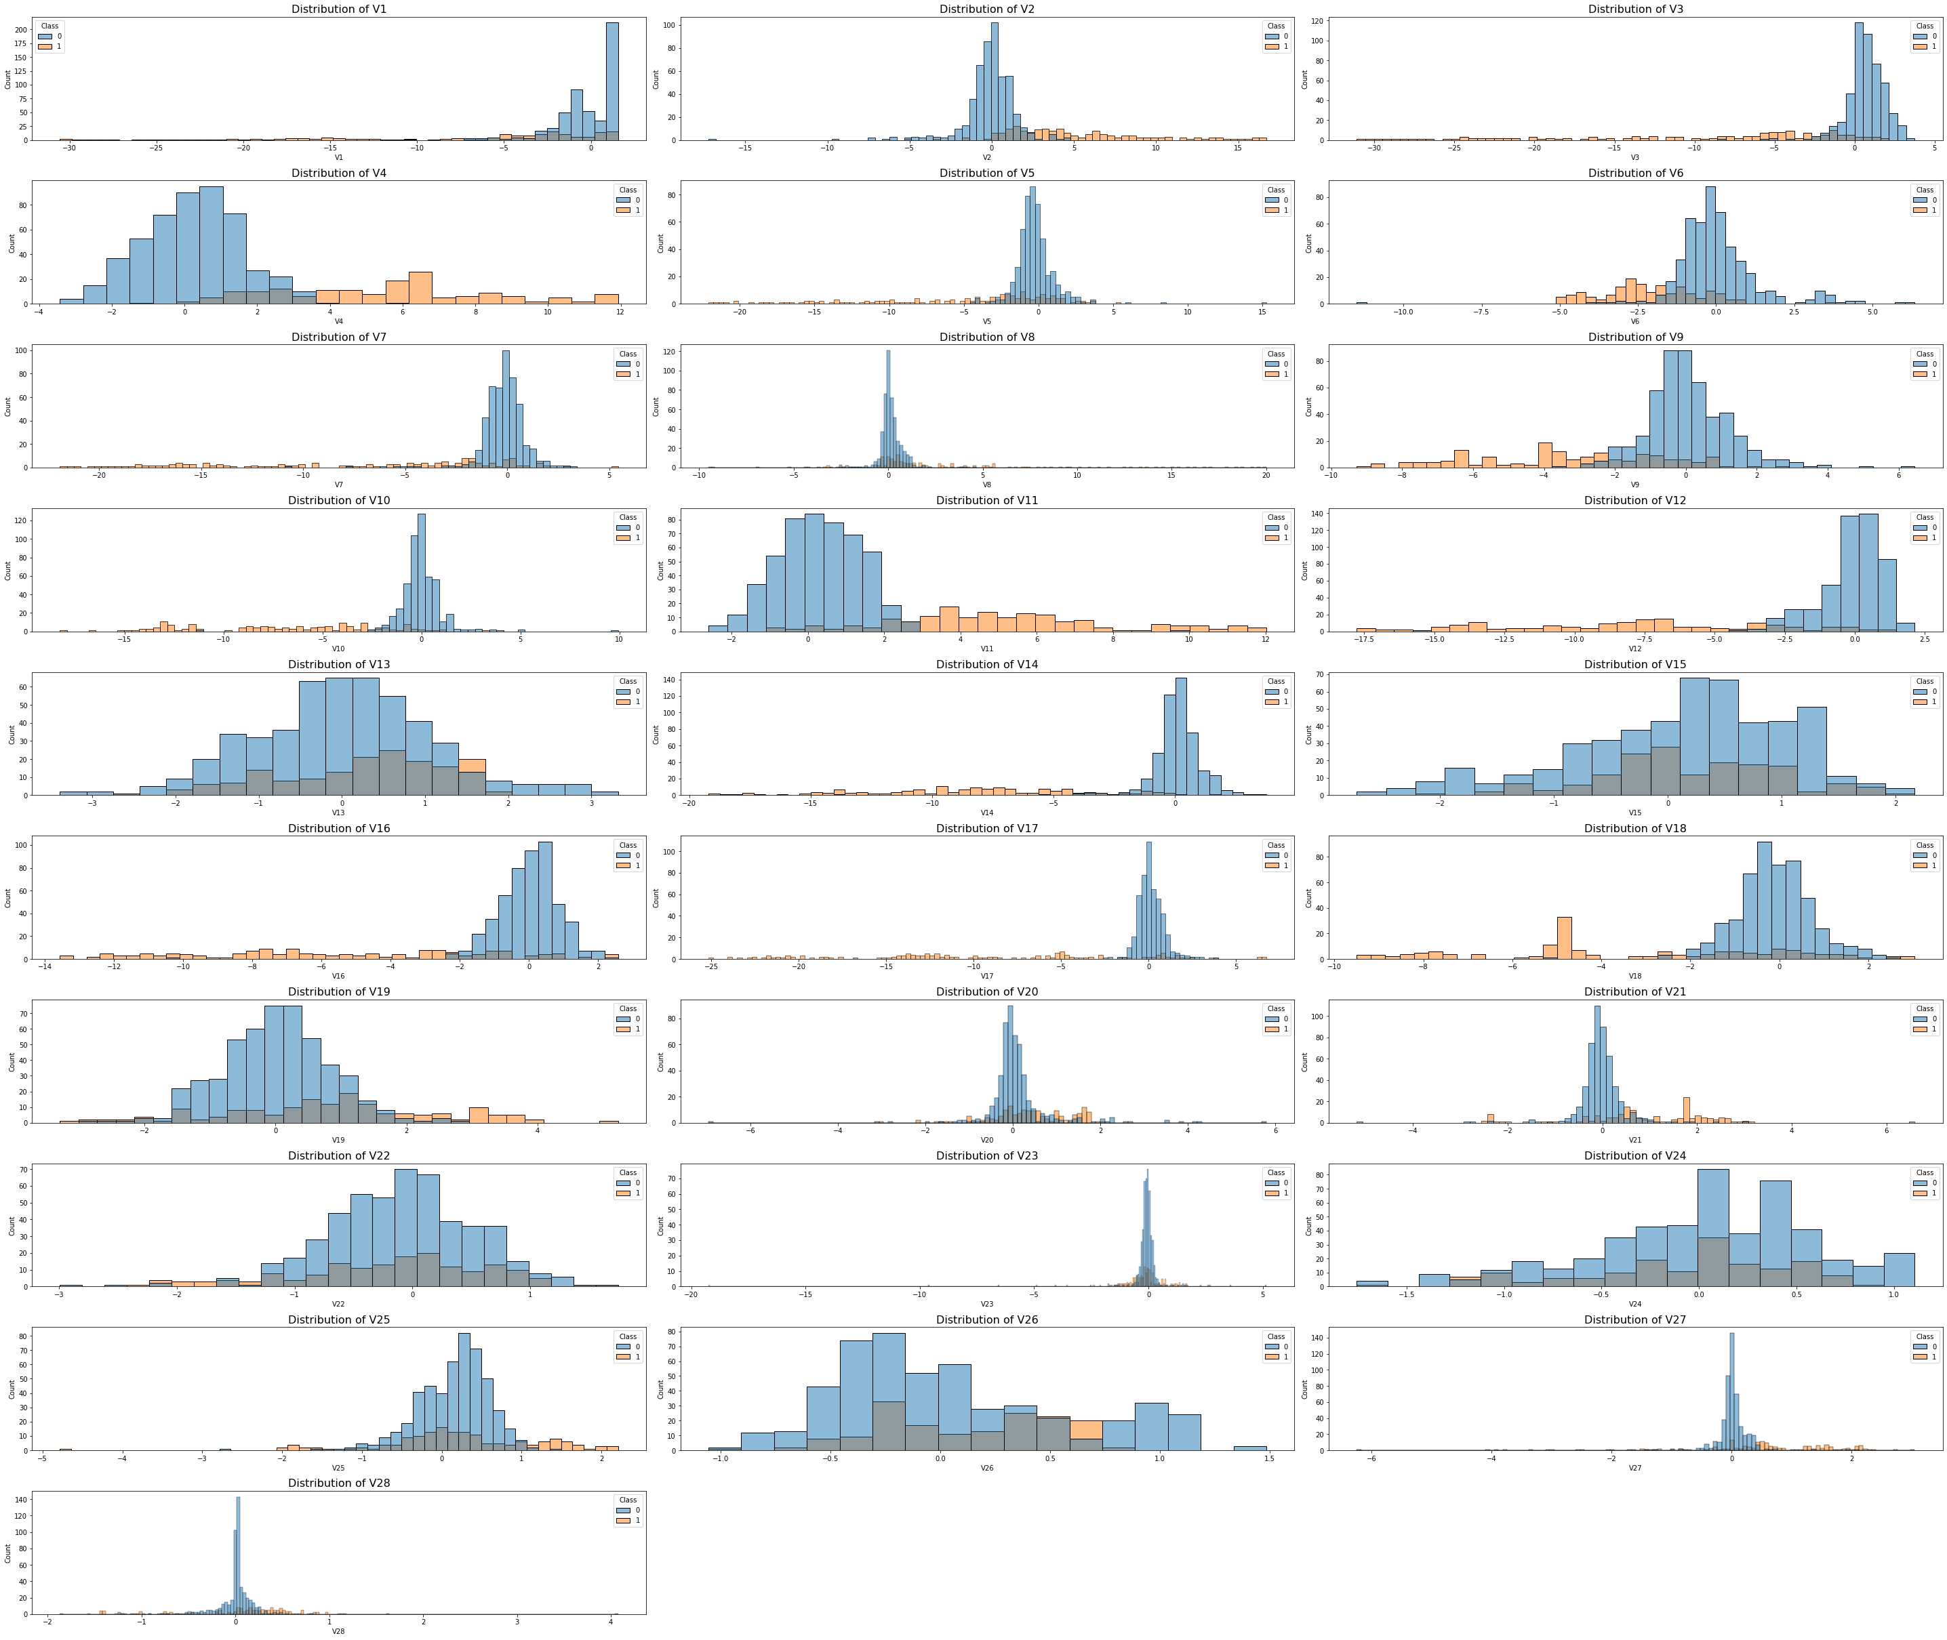
EDA
Attempted to remove outliers with original dataset
Resulted in removal of majority of fraud data
Features comparison against no fraud (0) and fraud (1)

Slide 7
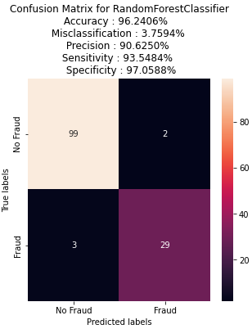
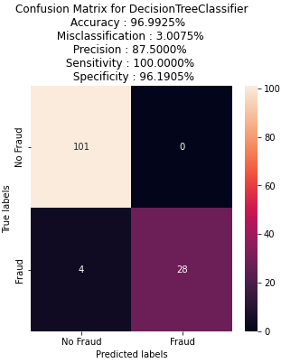
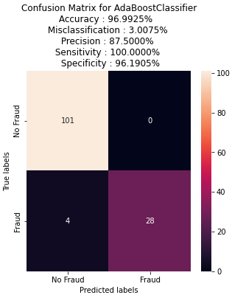
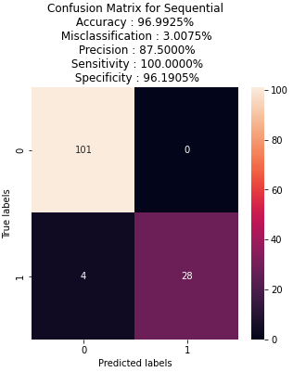
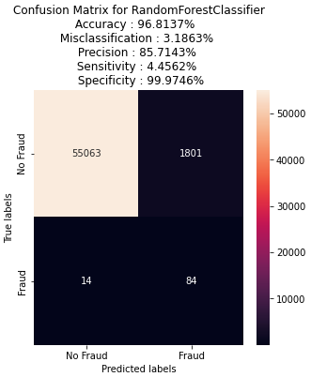

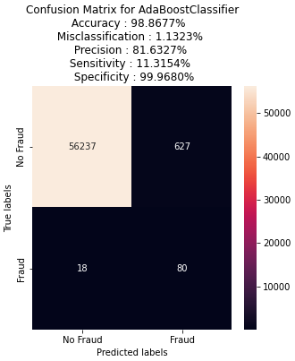
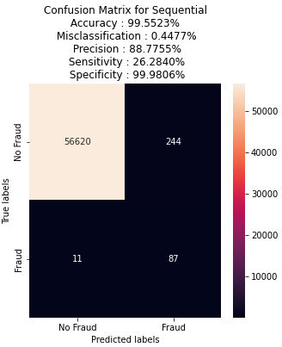
Models
Training on smaller dataset
Random forest
Decision Tree
AdaBoost
Sequential
Testing on larger dataset
Misclassification:
Random Forest
Precision:
Sequential
Sensitivity:
Decision Tree
Notes:
Accuracy (all correct / all)
= TP + TN / TP + TN + FP + FN
Misclassification (all incorrect / all)
= FP + FN / TP + TN + FP + FN
Precision (true positives / predicted positives)
= TP / TP + FP
Sensitivity aka Recall (true positives / all actual positives)
= TP / TP + FN
Specificity (true negatives / all actual negatives)
=TN / TN + FP
Layer (type) Output Shape Param #
=================================================================
dense (Dense) (None, 50) 1450
dense_1 (Dense) (None, 30) 1530
dense_2 (Dense) (None, 2) 62
=================================================================
Total params: 3,042 Trainable params: 3,042 Non-trainable params: 0

Slide 8
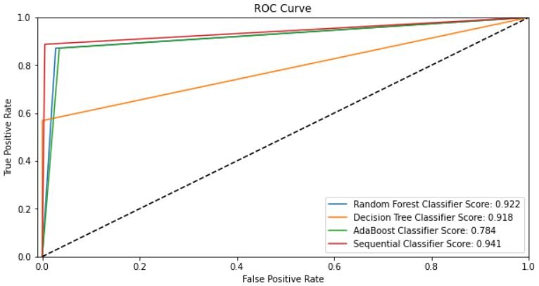
ROC curve comparison between models
3 out of 4 classifiers showing above 0.9 score
Better at distinguishing positive / negative class
AdaBoost showing lowest score for ROC curve of 0.78
Notes:
https://towardsdatascience.com/understanding-auc-roc-curve-68b2303cc9c5

Slide 9


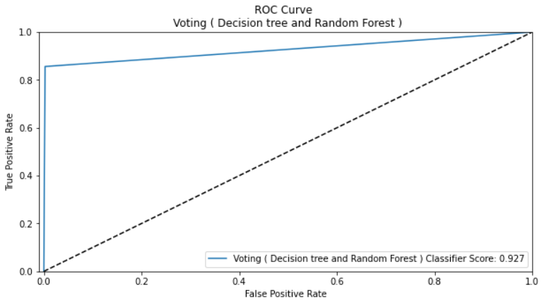
Voting Classifier
Voting Classifier
(Decision Tree and Random Forest)
Lowest misclassification
High specificity

Slide 10
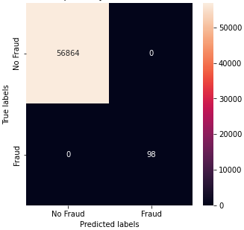
Summary
Voting Classifier provided the best results
Able to predict majority of fraud cases
Challenges:
Hidden column naming due to privacy
Next Steps:
Domain expert
To further test other classifiers and combinations
Increase number of actual fraud data
Once model is better trained, it can be used to warn the financial institutes of potential future fraud cases
Actual results

Slide 11
Thank you

